Slide 1

Piezophone™
Contact microphone for string instruments
@ohnoitsalobo_builds

Slide 2
About Me
B.Sc. Electrical Engineering
Old Dominion University, 2011
Mandolinist
Violist
Sound Engineer
Lemongrass Acoustic Trio

Slide 3
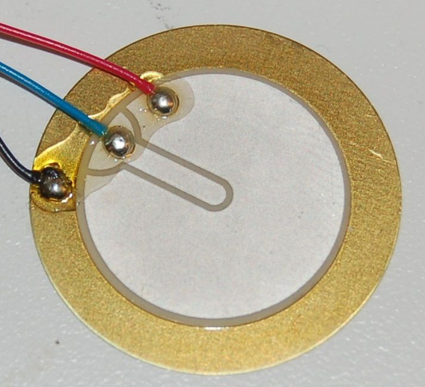
The Problem
Piezoelectric buzzer
- Cheap
- Readily available
- Fairly reliable
- normally used as a
speaker, quite loud

Slide 4
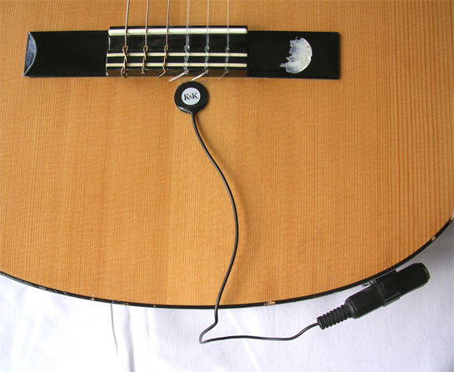
The Problem

Slide 5
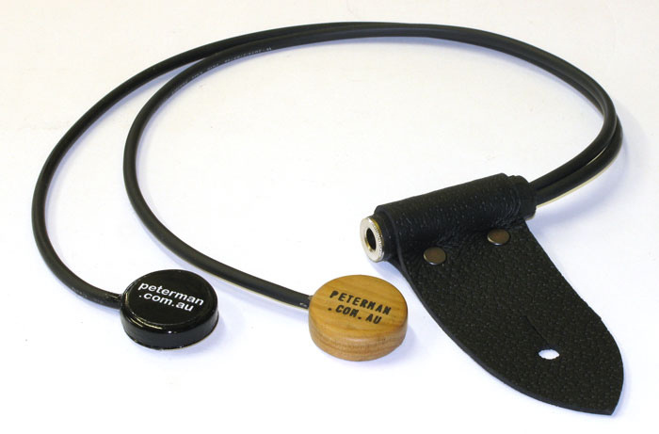
The Problem

Slide 6
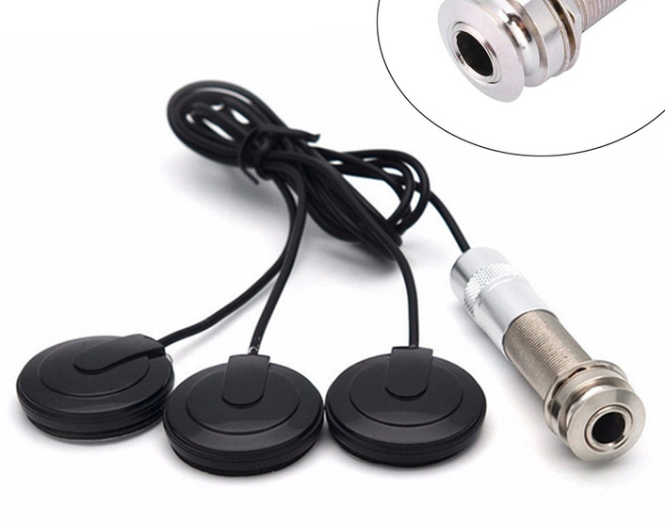
The Problem

Slide 7
The Problem
Piezoelectric discs are typically tuned as speakers in the range of 1-10kHz
Sold as-is with no information, common for DIY work
When connected to common audio systems without a special pre-amplifier, this results in impedance mismatch which produces a very poor tone, reinforcing the stereotype that "piezos are bad"

Slide 8
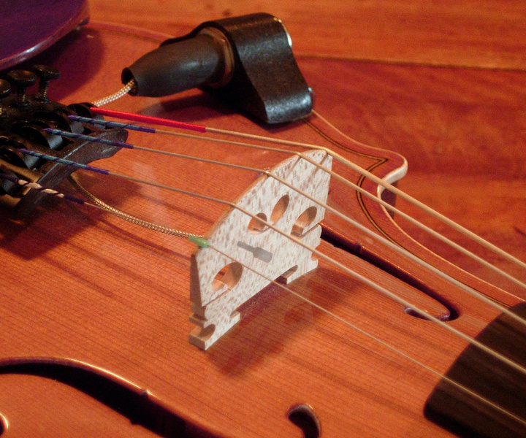
The Competition
Barcus Berry 1320
$120 (₹9600)
Replaces original bridge, which changes the sound
Bridge must be fitted by professional luthier at personal expense
Jack connector not included
Preamp provided at additional expense

Slide 9
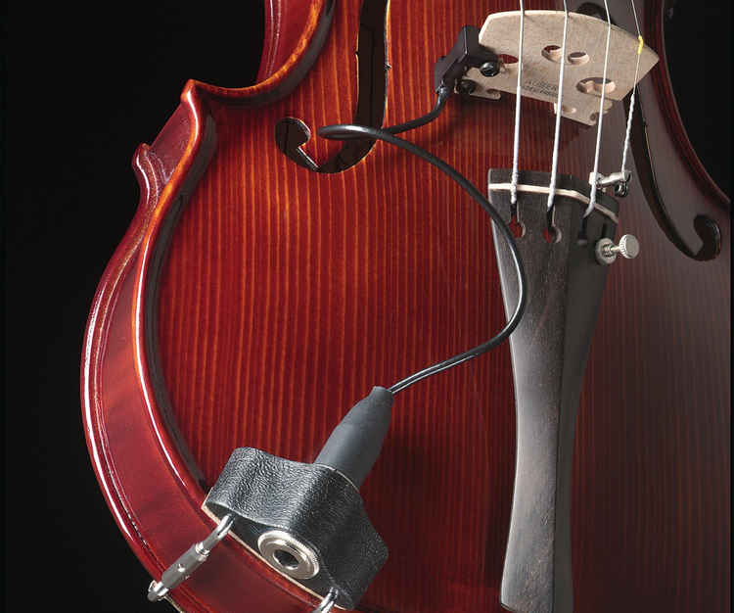
The Competition
Barcus Berry 3110
$350 (₹ 28,000)
Comes with passive preamp (does not require power)
Clamps on to existing bridge with screws
- additional weight changes the acoustic tone
- screws cause physical damage

Slide 10
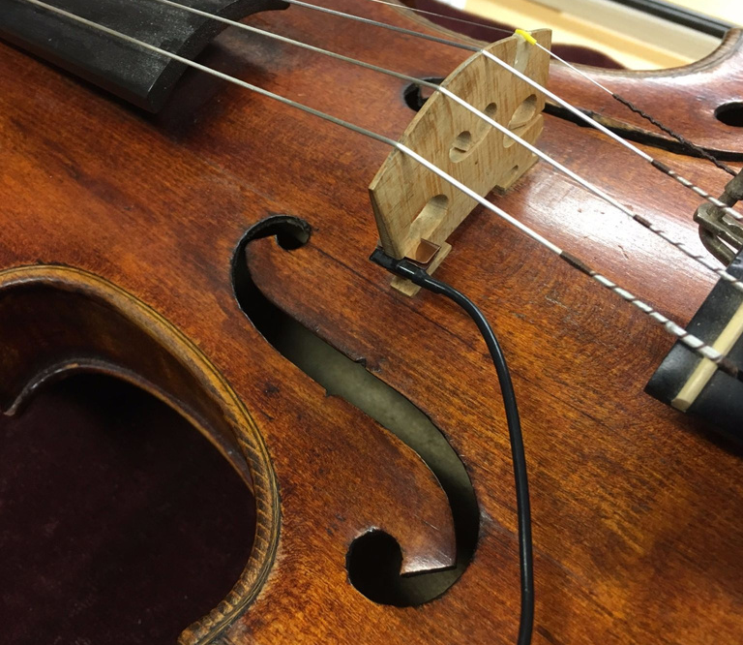
The Competition
Fishman V-200
$160 (₹12,800)
Attaches to bridge without damage
Changes acoustic tone
Preamp provided at additional expense

Slide 11
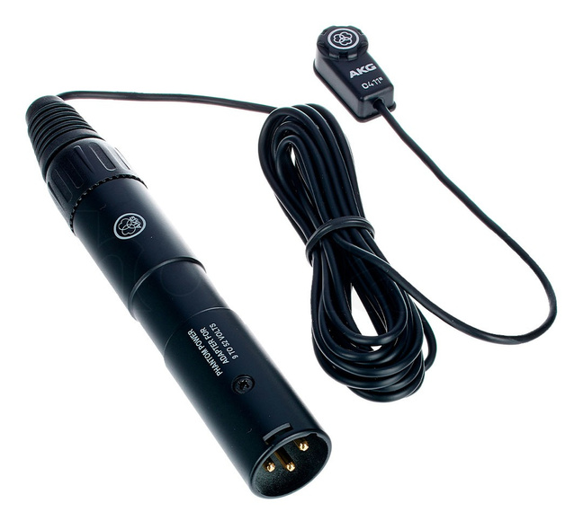
The Competition
AKG C-411
$200 (₹ 16,000)
Preamp not required;
electret mic, not piezoelectric
Attaches with black putty that leaves residue on instrument surface
Thin wire prone to damage

Slide 12
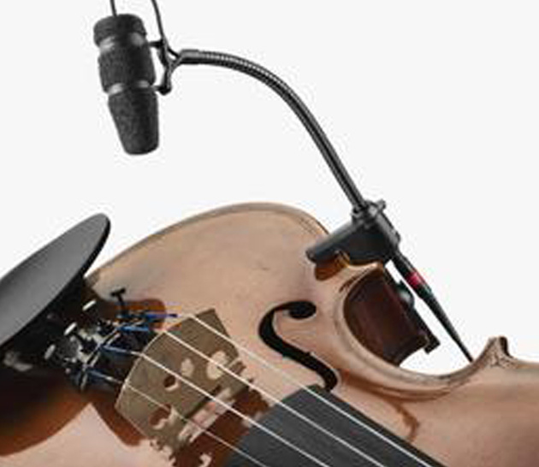
The Competition
DPA 4099
$600 (₹48,000)
Attaches to body without damage
Can be used with wind instruments
No preamp required
Prone to "feedback" at lower volumes

Slide 13
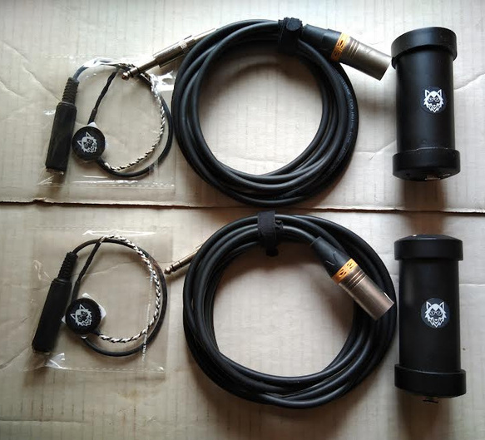
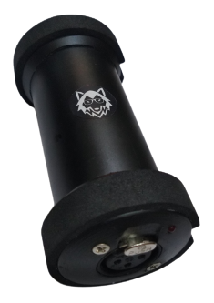
The Product
Piezo disc + custom cable + preamplifier

Slide 14
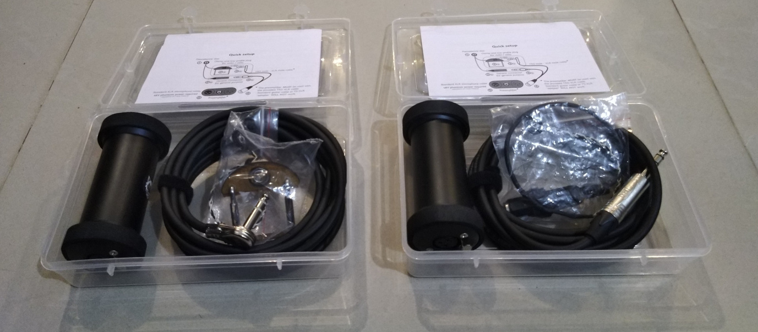
The Product
Piezo disc + custom cable + preamplifier

Slide 15
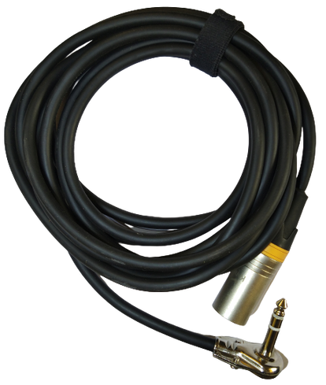
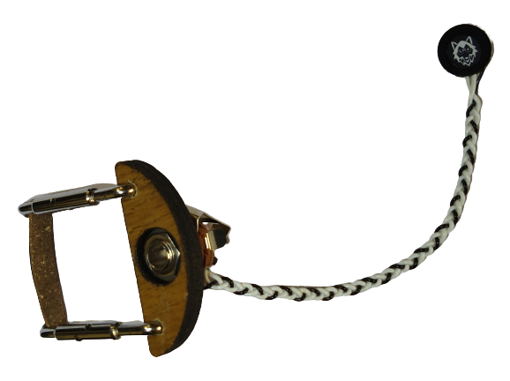
The Product
Violin clamp + low-profile plug

Slide 16
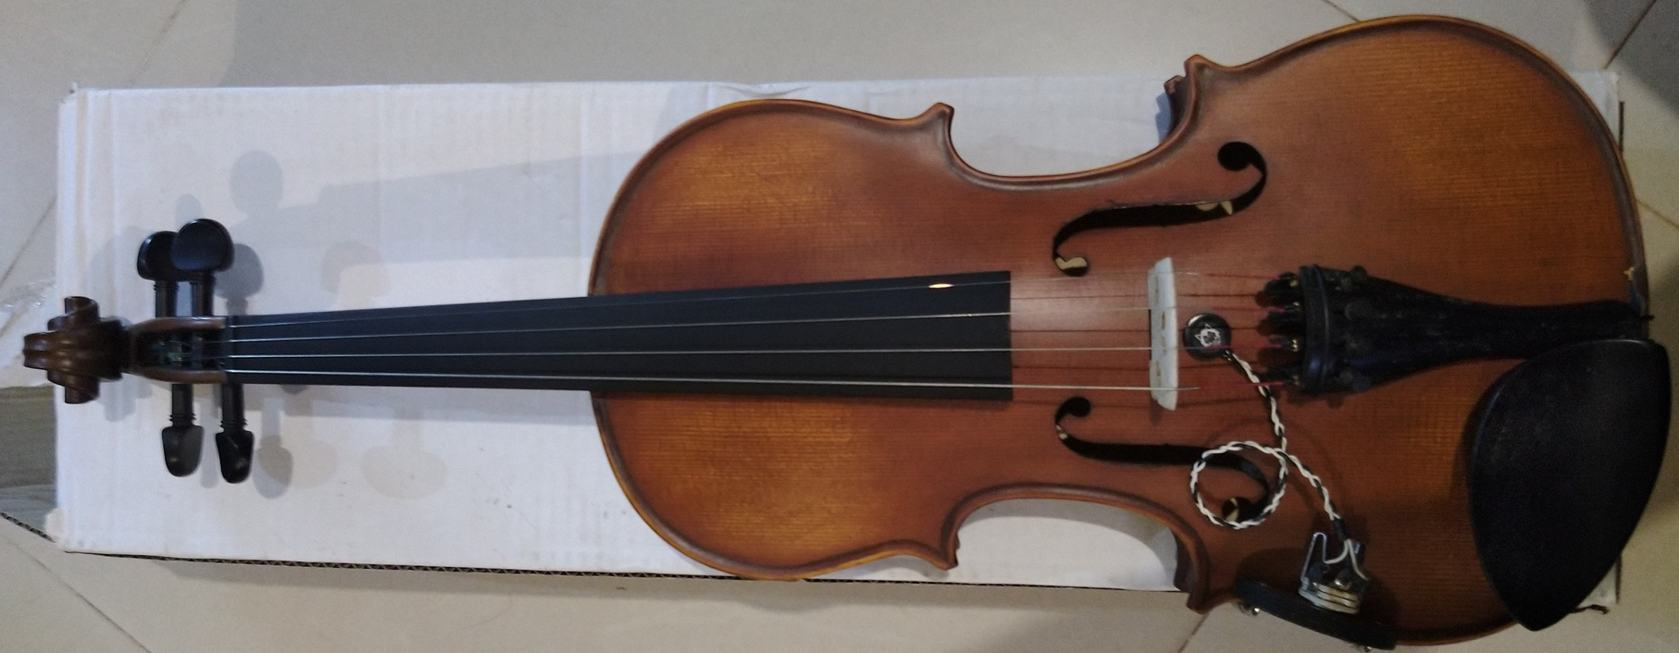
The Product
Violin mounting clamp

Slide 17
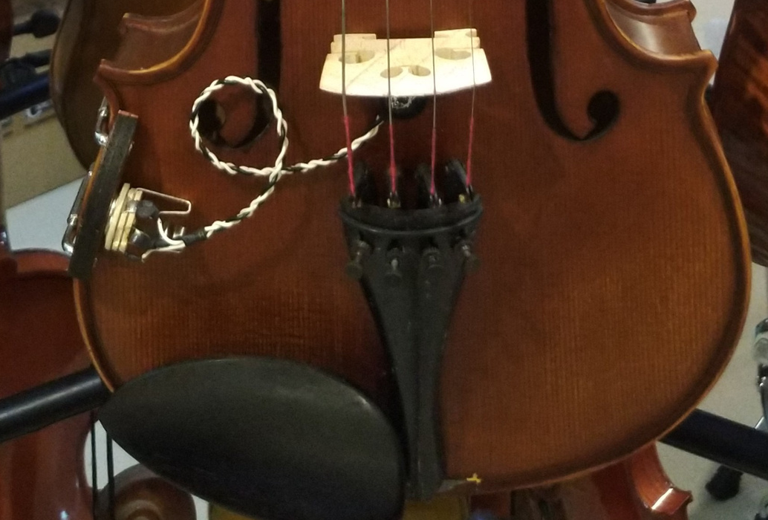
The Product
Violin mounting clamp

Slide 18
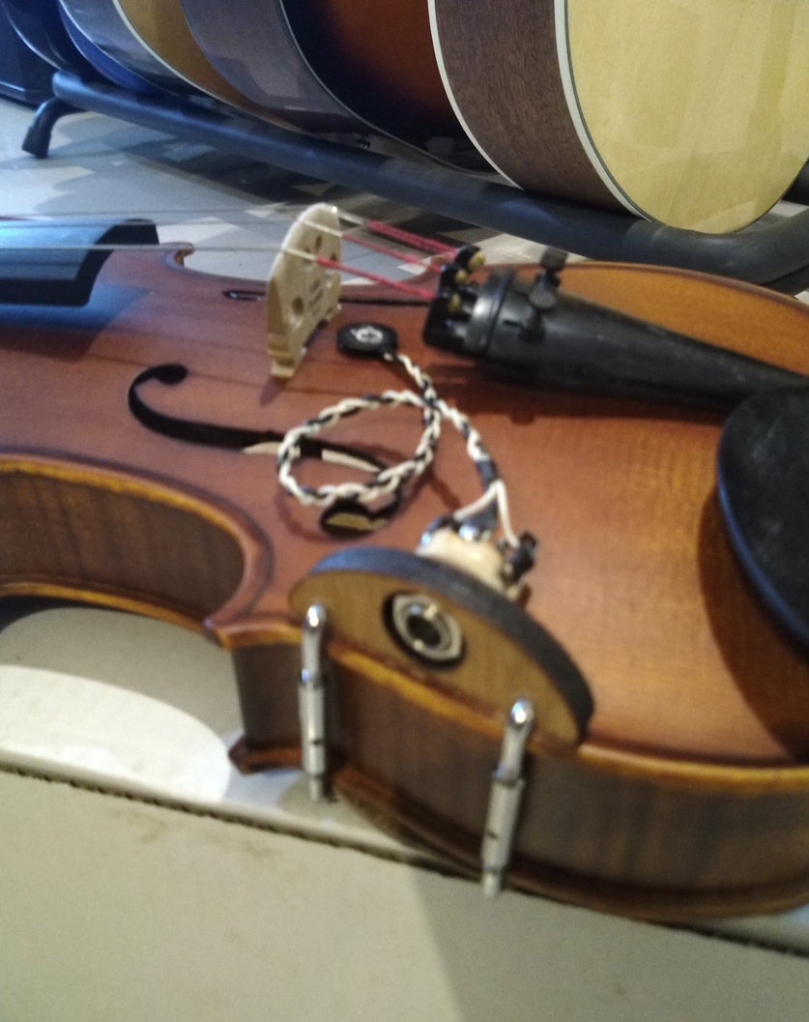
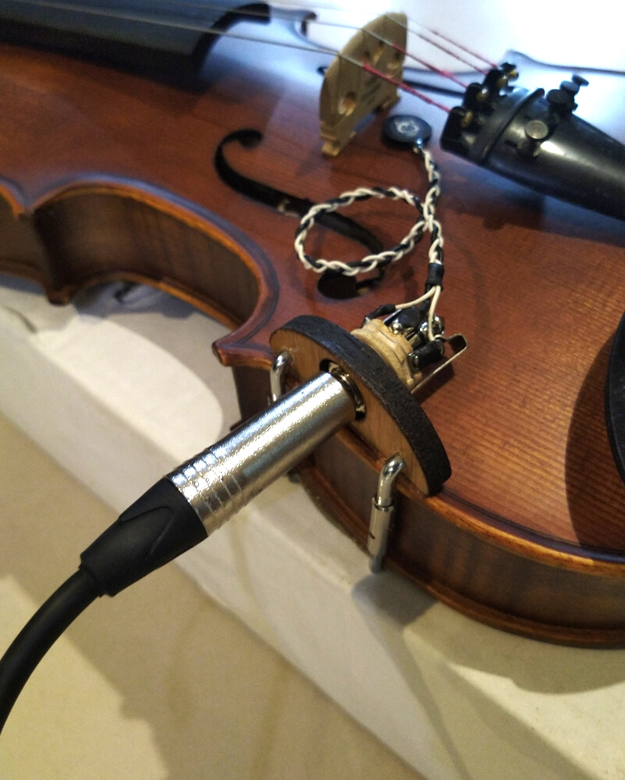
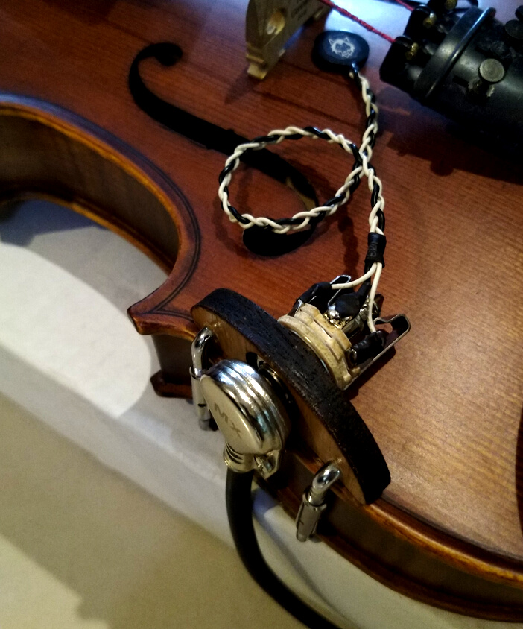
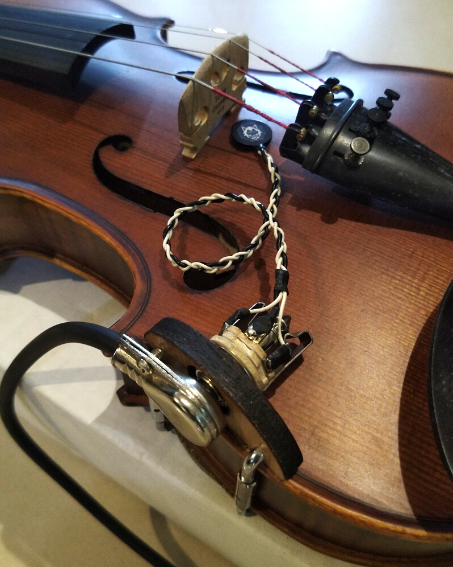
The Product
Violin mounting clamp

Slide 19
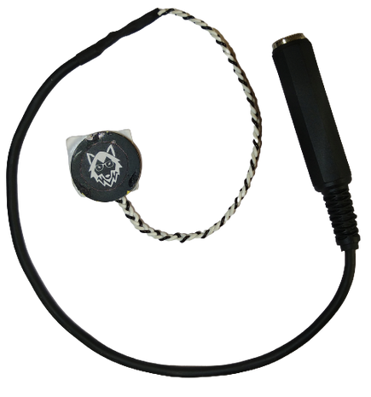
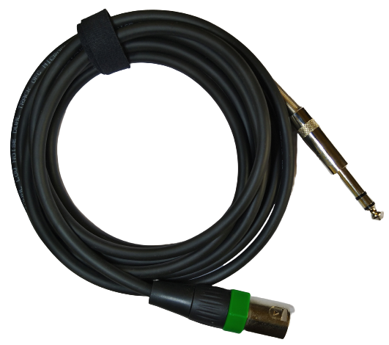
The Product
"Generic" piezo + straight plug

Slide 20
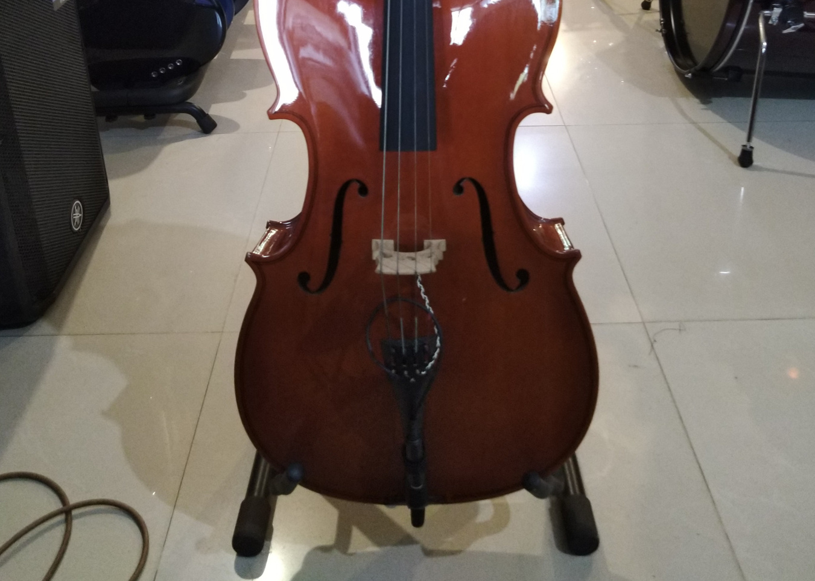
The Product
"Generic" piezo attachment

Slide 21
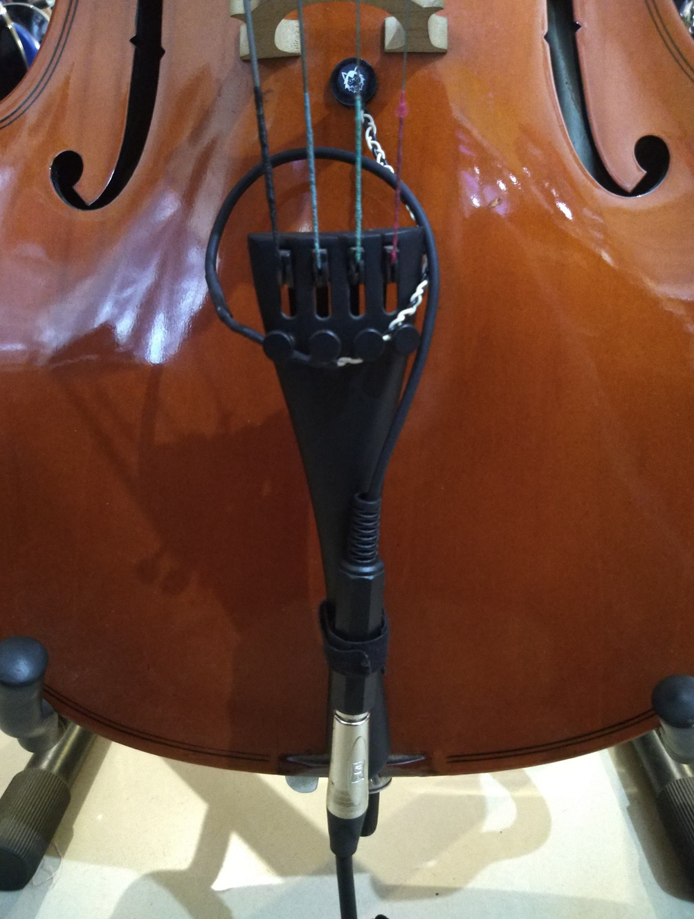
The Product
"Generic" piezo attachment

Slide 22
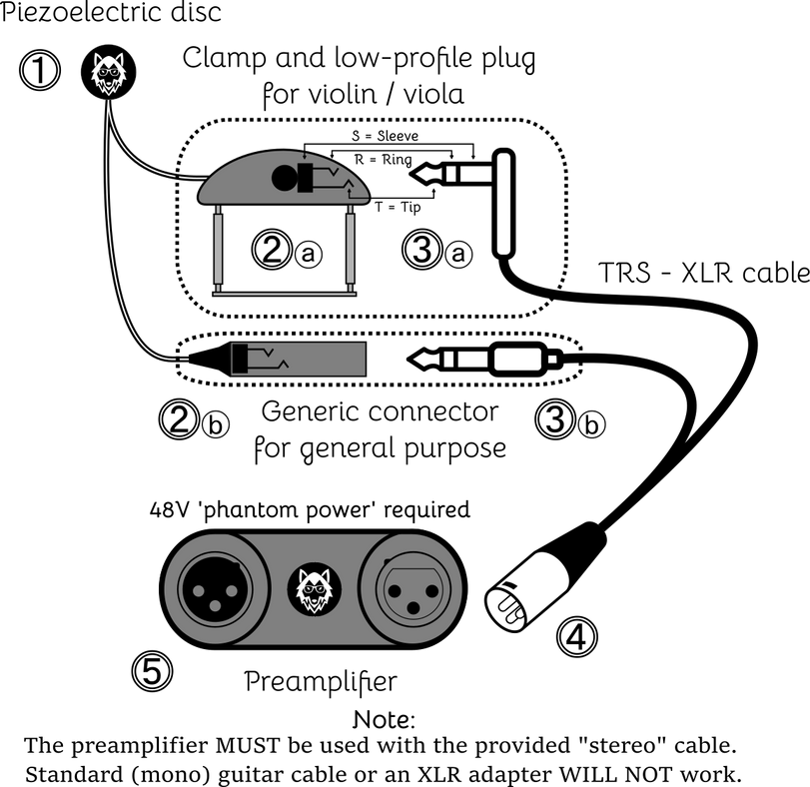
The Product

Slide 23
The Product
Unit price: ₹16,000
Lead time: 1 week / batch of 10 units
Included:
1x piezoelectric disc (choice of violin or 'generic')
1x TRS - XLR cable (choice of straight or low-profile)
1x preamplifier
Phantom-powered preamplifier module requires no batteries; powered from the audio interface directly.
"Balanced signal" (differential signal) is highly resistant to EMI.

Slide 24
The Product
Advantages compared to competitors:
attaches to instrument body rather than bridge, preserving acoustic tone; this also provides a better-sounding audio
Faber-Castell™ "Tack-It" putty leaves no residue and can be re-used many times
suitable for bass instruments e.g. cello and double-bass
preamplifier included in price
no batteries required, only 'phantom power' which is available on all modern interfaces

Slide 25
The Plan
Contact with Kadence Music / Yamaha / etc
Sold through Pedro Fernandes music shop
Collaboration with string performers in Goa / Mumbai
Demo through Lemongrass Trio performance
Partner with recording studio / music school

Slide 26
Frequently Asked
Questions / Challenges
Volume / tone control?
Similar to common vocal / instrument microphones e.g. Shure SM-58. Adjustment done at mixer.
Wireless?
Parts cost and fabrication time more than double, plus additional cost / special qualification for wireless design and certification.

Slide 27
Frequently Asked
Questions / Challenges
Battery?
Option may be added in future, but quality not as good due to lower 'headroom'.
Percussion?
Not recommended.
Parts supply; PCB and certain plugs have to be imported to ensure quality.

Slide 28
Market
String instruments
Indian instruments
Foley artists
Recording studios
Nature recording
Hydrophone (underwater mic)
Laryngophones (throat mic)
Industrial monitoring (?)
ASMR

Slide 29
Investment
- Design can be licensed after patent is secured
- Require investment up to 5 lakhs for:
parts bulk purchase
import fees
workshop rental
purchase of power tools and supplies
hire assistance to assemble units

